Slide 1

Cross-chain technology
Enhancing Blockchain Interaction

Slide 2
Background

Slide 3
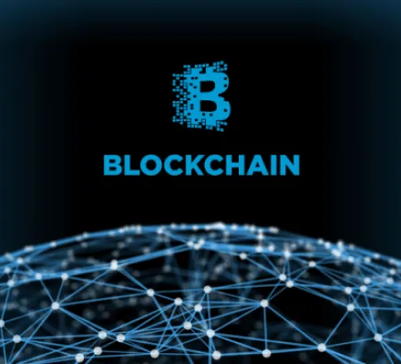
A blockchain is a decentralised digital ledger that documents transactions across numerous computers, ensuring that these transactions cannot be altered after the fact[1]. It encompasses elements like decentralisation, immutability, transparency, and security.

Slide 4

interoperability
The ability of systems to communicate with each other [2]
The interaction of several systems whose elements or languages are different from each other and the successful intercommunication between them [3]
How to ensure the interoperability between blockchains when each one is independent from others, the information flows in a vertical manner?

Slide 5
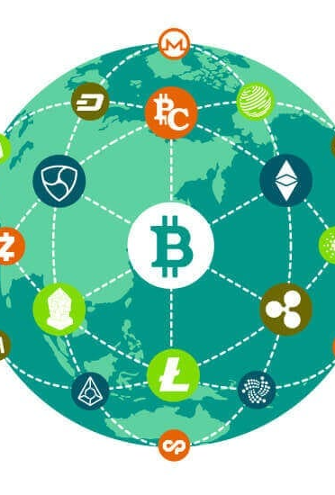
Cross-Chain
Refers to the ability to transfer data and tokens between different blockchain networks.[4]
Process to ensure interoperability.
Most popular mechanisms for cross-chain:
Atomic Swaps
Sidechains
Notary Schemes
Bridges

Slide 6
Literature review

Slide 7
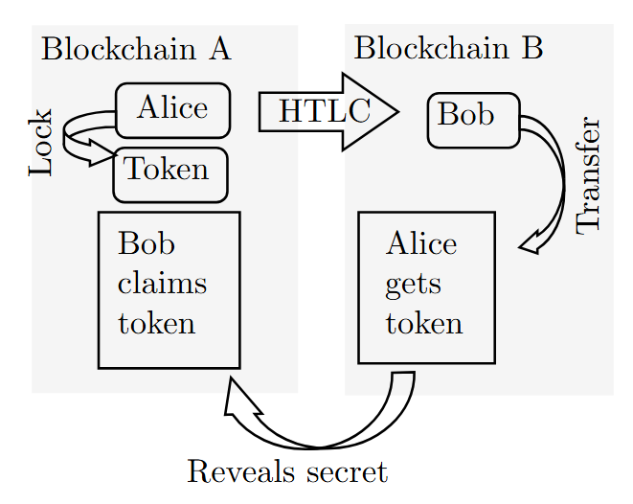
Atomic swaps
Allows users to exchange digital assets directly across different blockchains without intermediaries.
Works with encryption algorithms and timing for a correct exchange. This means that by not acting in a rational way, the system is broken, and the actor is the least benefited.[5]
Strengths | Weaknesses
High Security Decentralisation Cost Efficiency | Low user experience Limited compatibility Moderate Speed

Slide 8
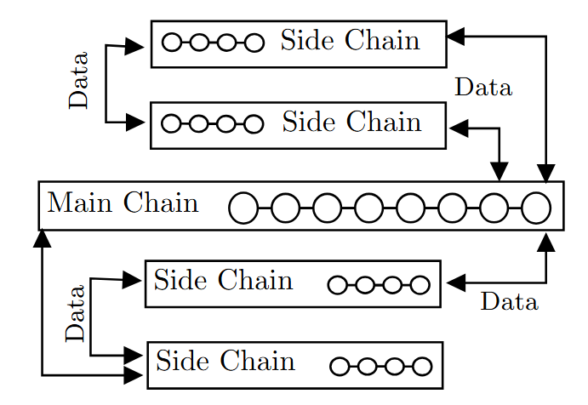
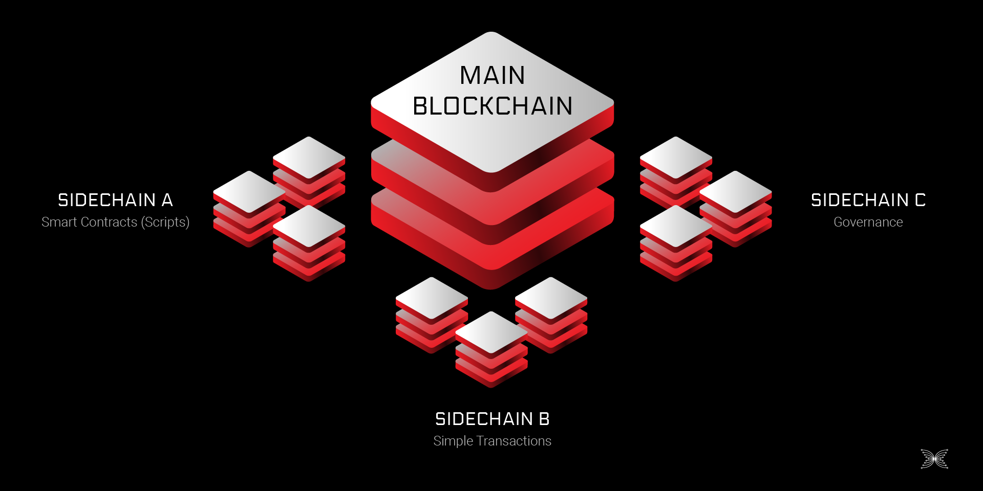
Sidechains
Separate blockchains that run parallel to the main chain, allowing assets to be transferred between them.
Allows two blockchains to interoperate, extend, or up-grade, with one blockchain (sidechain) anchoring another (main chain)[6]
Strengths | Weaknesses
Scalability Speed | Centralization Risks Limited compatibility Moderate user experience

Slide 9

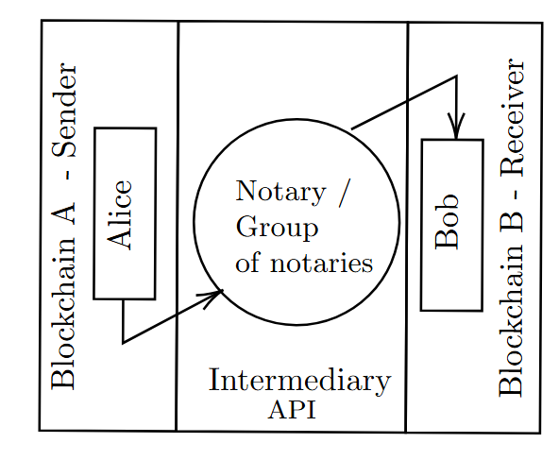
Notary Schemes
Assumes that the sending chain A and target chain B cannot trust each other, requiring a third-party notary as an intermediary.[6]
Both chains must set up a unified protocol notary certification contract interface.
Strengths | Weaknesses
High User Experience Speed Compatability | Low Decentralisation Moderate Security Potential bottlenecks

Slide 10
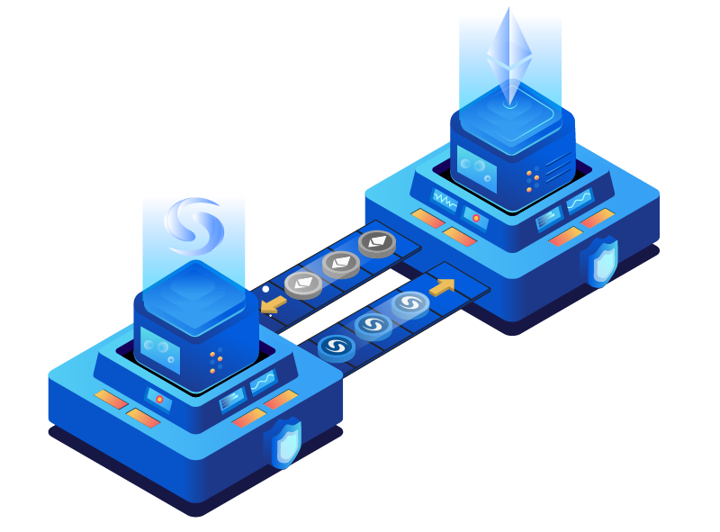
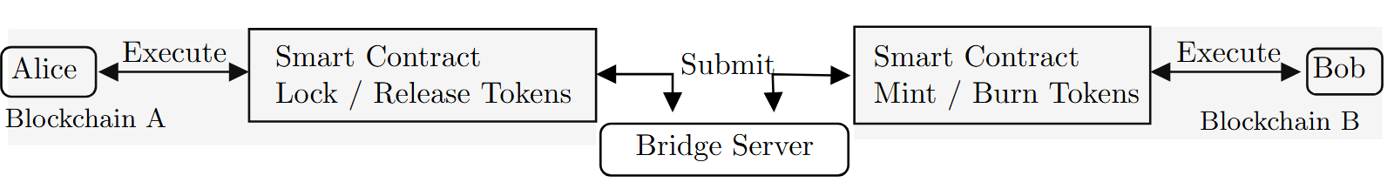
Bridges
Strengths | Weaknesses
User Experience Decentralisation Security | Scalability Compatibility Operational complexity
Allow the user to exchange assets through decentralized protocols and help to maintain the original values of the asset, thus enabling interoperability between blockchains.[4]
Not only cryptocurrencies but also nonfungible tokens can be transferred as well. Another common use of bridges is staking that locks a certain amount of assets to generate passive income on different blockchains[7]

Slide 11
Research question
How can cross-chain interoperability protocols be improved to enhance performance, security, and user experience in decentralized blockchain ecosystems?
What are the comparative strengths and weaknesses of existing cross-chain protocols such as AtomicSwaps, Sidechains, Notary Schemes, and Bridges?
How does the Intent-Based Bridge (IBB) model address the limitations of traditional cross-chain protocols?
What are the measurable performance differences (e.g., speed, cost, scalability) between IBB and other protocols under simulated or real-world conditions?
What improvements can be proposed to enhance the effectiveness and adoption of cross-chain interoperability protocols?

Slide 12
Aims of the research/own contribution
Aims to critically evaluate and enhance cross-chain interoperability protocols within decentralized blockchain ecosystems. The primary focus is on the emerging Intent-Based Bridge (IBB) model.
Conduct a comparative analysis of existing cross-chain protocols.
Investigate the architectural and operational features of Intent-Based Bridge.
Simulate or analyze real-world data to compare the performance of IBBs against traditional protocols.
Identify gaps and propose enhancements to improve the effectiveness.

Slide 13
Significance
The lack of seamless and secure communication between blockchains remains a major bottleneck. Despite numerous protocols being available, each presents trade-offs that hinder scalability, decentralization, or ease of use.
• It addresses a critical gap in the literature by providing one of the first academic evaluations of IBB.
• It contributes to the ongoing discourse on blockchain interoperability.
• It supports developers and protocol designers in identifying key areas for improvement and innovation.
• It enhances user-centric design in blockchain systems by evaluating protocols not only on technical metrics but also on usability and accessibility.

Slide 14
Research strategy, approach, and methodology
Strategy: Comparative & exploratory study of cross-chain interoperability protocols, with a focus on the novel Intent-Based Bridge (IBB) model.
Approach: Mixed-methods:
Qualitative: Analyze architecture, decentralization, trust models, and UX via documentation and whitepapers.
Quantitative: Evaluate performance (speed, cost, reliability) using real-world and experimental data.
Methodology:
Literature Review – Identify gaps and inform evaluation criteria.
Comparative Analysis – Assess protocols (e.g., Atomic Swaps, Sidechains) using a standardized framework.
Data Collection – Use blockchain explorers/APIs for real-world data.
IBB Prototype – Develop and test in simulated environments.
Synthesis – Compare findings, refine IBB, and propose implementation recommendations.

Slide 15

Intent-based Bridge

Slide 16
What it is?
Novel idea to transfer tokens between bridges mitigating risks of handling assets through bridges.
Customer does not need to be an expert to exchange assets
Validators as new agents to provide liquidity to transfer
Auctions to fullfil the intent of a customer

Slide 17

How it works

Slide 18
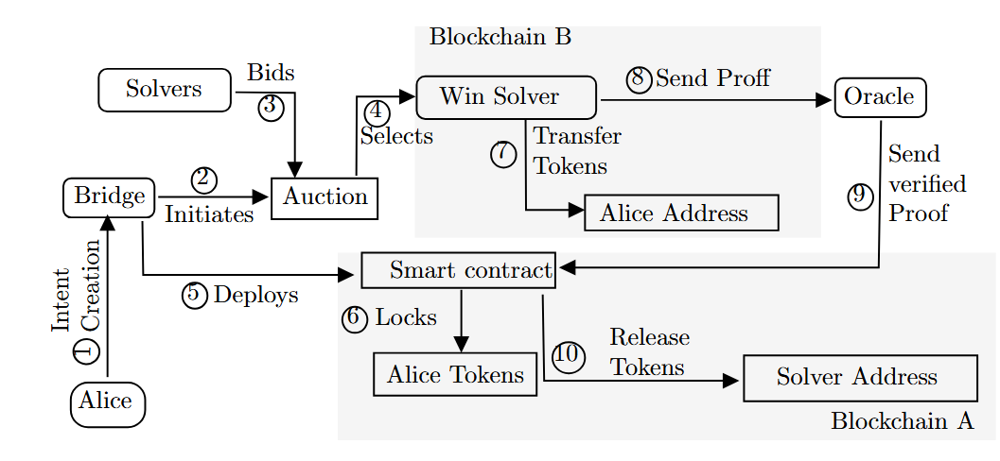
Process

Slide 19
Data gathering
Dual Data Collection:
Empirical: Real-world blockchain data from bridges (e.g., Polygon, Wormhole) and DEXs via explorers (Etherscan, Polygonscan) and APIs (The Graph, Covalent).
Experimental: Simulated IBB protocol behavior using testnets (Goerli, Mumbai) and tools (Hardhat, Remix, Ganache).
Empirical Focus:
Collect transaction-level metadata: timestamps, gas usage, token amounts, contract IDs, event logs.
Analyze performance: speed, cost, reliability.
IBB Simulation:
Prototype IBB workflow: intent submission, solver bidding, contract execution, oracle verification.
Generate synthetic data: solver response time, bid values, execution latency.
Analysis Techniques:
Quantitative: Descriptive stats, visual comparisons (bar charts, radar plots).
Qualitative: Review of architecture, UX, decentralization, and trust models.
Synthesis: Integrate findings into a structured evaluation framework.

Slide 20
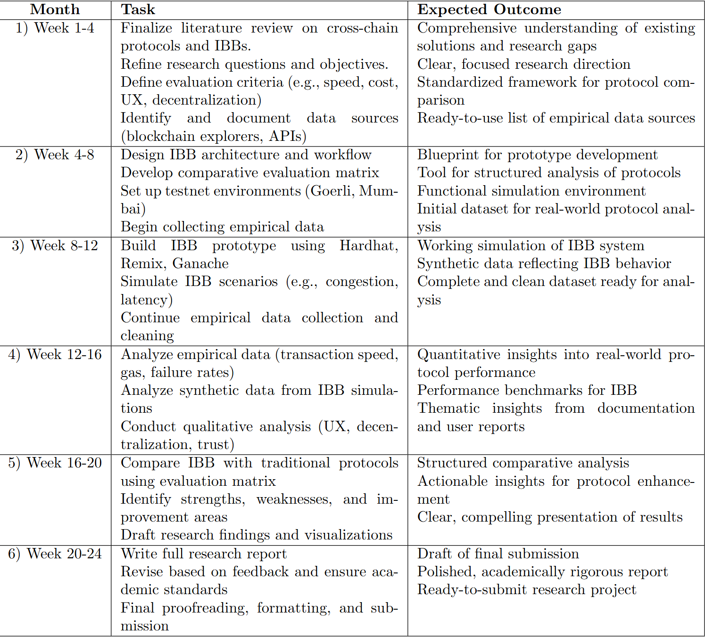
timeline

Slide 21
Q&A

Slide 22
References
[1]S. Nakamoto, “Bitcoin whitepaper,” URL: https://bitcoin. org/bitcoin. pdf-(: 17.07. 2019), vol. 9, p. 15,2008.
[2] Pillai, B., Biswas, K., H´ou, Z., Muthukkumarasamy, V.: Level of concep-tual interoperability model for blockchain based systems. In: 2022 IEEECrosschain Workshop (ICBC-CROSS). pp. 1–7. IEEE (2022)
[3] Belchior, R., S¨ußenguth, J., Feng, Q., Hardjono, T., Vasconcelos,A., Correia, M.: A brief history of blockchain interoperability. Com-mun. ACM 67(10), 62–69 (Sep 2024). https://doi.org/10.1145/3648607,https://doi.org/10.1145/3648607
[4] Li, N., Qi, M., Xu, Z., Zhu, X., Zhou, W., Wen, S., Xiang, Y.: Blockchaincross-chain bridge security: Challenges, solutions, and future outlook. Dis-trib. Ledger Technol. 4(1) (Feb 2025). https://doi.org/10.1145/3696429,https://doi.org/10.1145/3696429
[5] Herlihy, M.: Atomic cross-chain swaps. In: Proceedings of the 2018 ACMsymposium on principles of distributed computing. pp. 245–254 (2018)
[6] Mao, H., Nie, T., Sun, H., Shen, D., Yu, G.: A survey on cross-chain tech-nology: Challenges, development, and prospect. IEEE Access 11, 45527–45546 (2023). https://doi.org/10.1109/ACCESS.2022.3228535
[7] Zhang, M., Zhang, X., Barbee, J., Zhang, Y., Lin, Z.: Sok: Security ofcross-chain bridges: Attack surfaces, defenses, and open problems (2023),https://arxiv.org/abs/2312.12573

